Slide 1
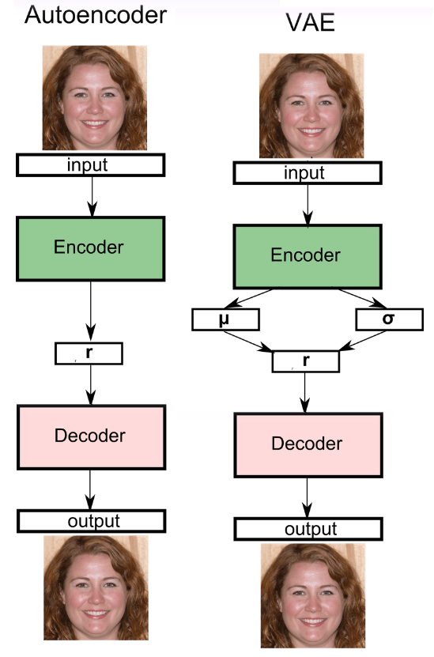
Variational Autoencoders
The architecture of the VAE actually closely resembles that of the Autoencoder, with the main difference being that the input is encoded into two vectors, rather than one. These two vectors are used to define a normal distribution, where the latent representation of the input is then drawn from.

Slide 2
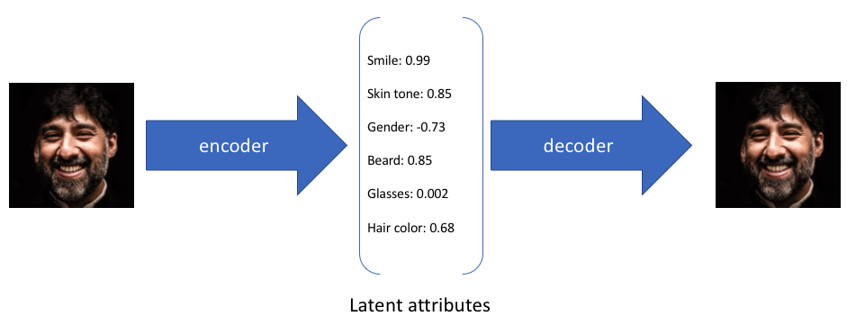
Variational Autoencoders
In the example above, we've described the input image in terms of its latent attributes using a single value to describe each attribute.
However, we may prefer to represent each latent attribute as a range of possible values.
For instance, what single value would you assign for the smile attribute if you feed in a photo of the Mona Lisa?
Using a variational autoencoder, we can describe latent attributes in probabilistic terms.

Slide 3
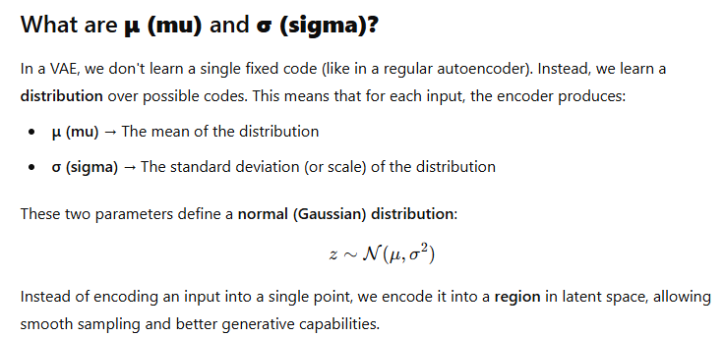

Slide 4



Slide 5




Slide 6
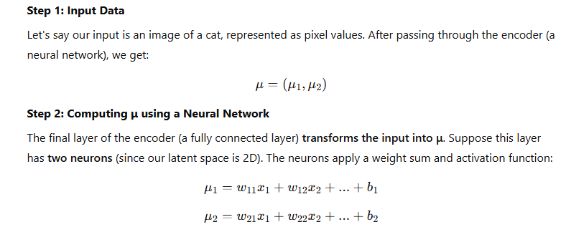


Slide 7
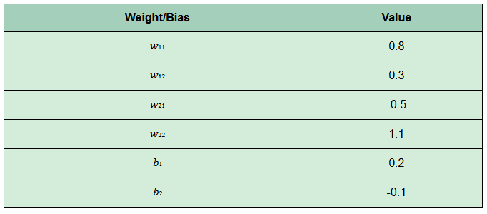
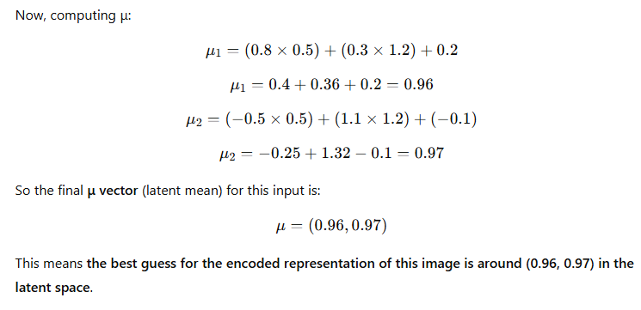

Slide 8



Slide 9
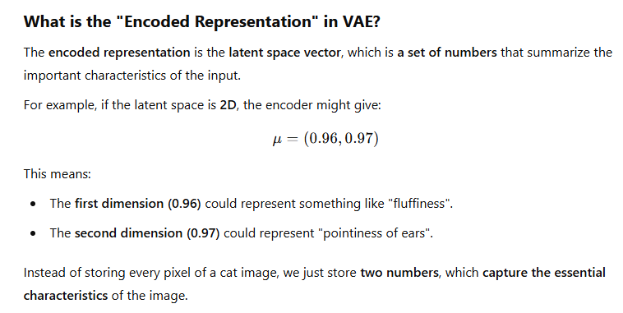

Slide 10
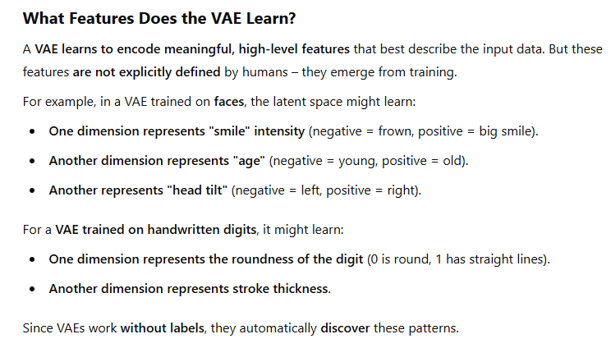

Slide 11
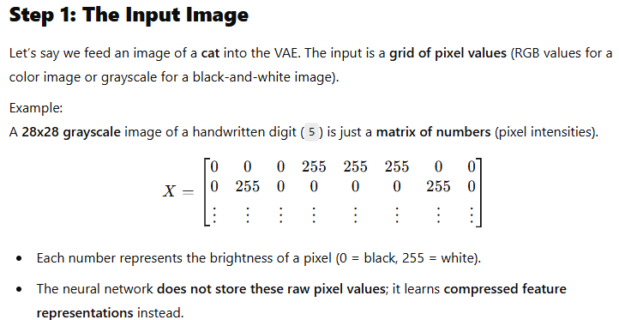

Slide 12
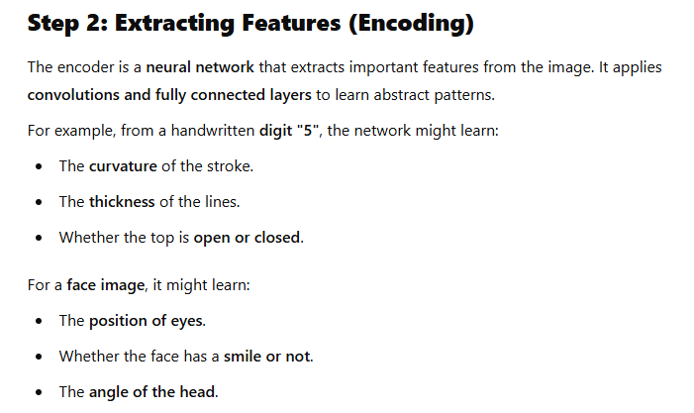

Slide 13
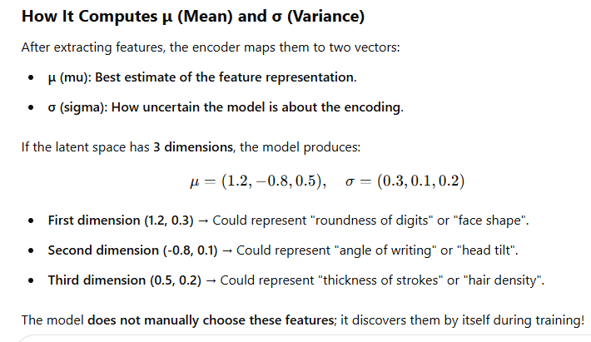

Slide 14
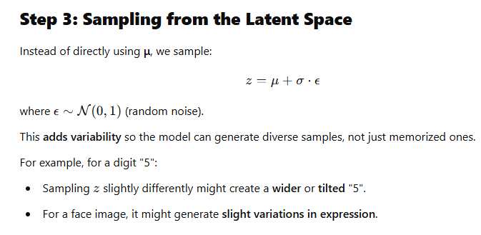

Slide 15
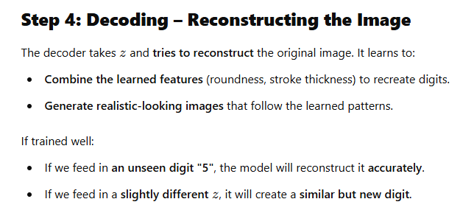

Slide 16
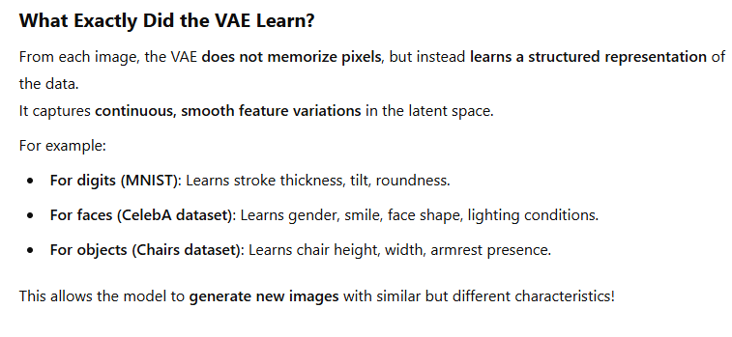

Slide 17
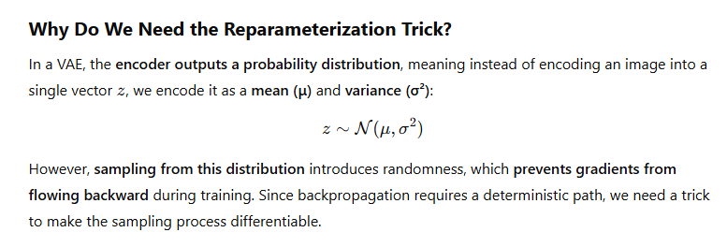

Slide 18
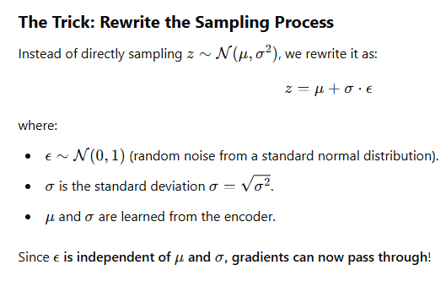

Slide 19
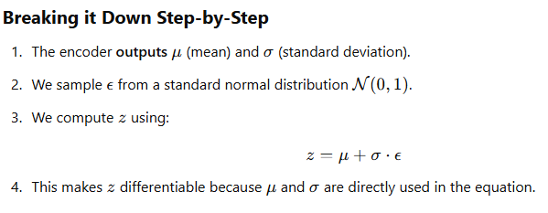
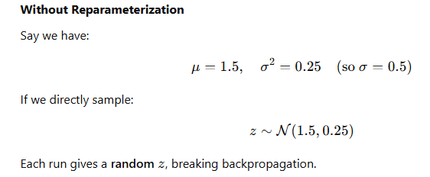

Slide 20
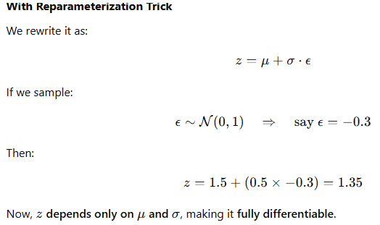

Slide 21
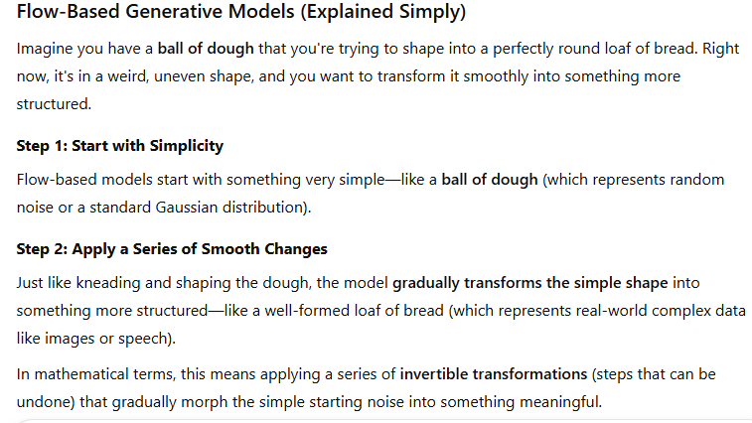

Slide 22


Slide 23


Slide 24



